Slide 1
Bank Loan Strategy Finalization
Prepared by,
Saumalya Ghosh

Slide 2
Objective of this Project
Find out appropriate client who are not having any payment difficulties in repaying loan. Financial Institutions like Banks/NBFCs have business opportunities if they will enroll these customers into their bucket list.
Find out applicant who are facing payment difficulties at present or have history of becoming loan defaulter. Financial Institutions like Banks/NBFCs should not approve loan application request from these customers as it seems to be an indicator for potential business loss.
Analyze data of all the applicants and offer/reject loan request based on merit.

Slide 3
Steps of the Assignment
Fair understanding of each column description.
Import necessary libraries
Load the data
Basic sanity check of the data
Check and find out columns consists of Missing Values more than 40%
Clean/Remove columns having Missing Values more than 40%
Find out Data Imbalance and Evaluate Ratio of Imbalance
Assess Univariate and Bivariate Analysis of present and previous loan applications; Find out spread of non-defaulter and defaulter client.
Find out 5 potential Outliers in the dataset supported by logical reasoning

Slide 4
Univariate Analysis on Target Variable

Slide 5
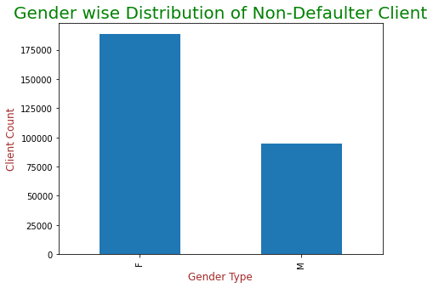
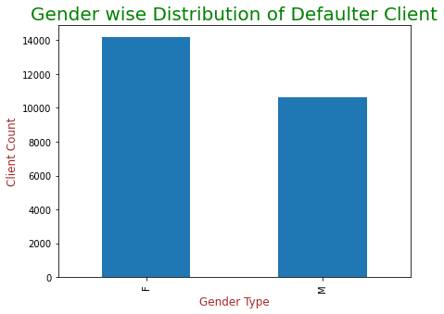
Gender wise Distribution
Non-Defaulter Female Clients are much in number (More than 1.75 L) compared to Male Client (More than 0.75 L).
On the other hand, Female Client having loan payment difficulties are also higher (Around 0.14 L) than Male Client (0.1 L).
Financial Institutions should focus on Male applicant who are likely to repay the loan.

Slide 6
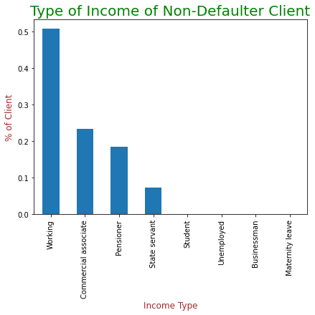
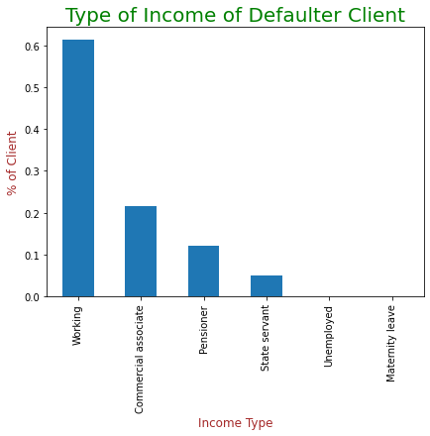
Client Income Type wise Distribution
Working professionals have the highest spread both in Non-Defaulter (~50%) and Defaulter category (~60%)
Financial Institution should approve loan to Student and Businessman who are likely to repay the loan.

Slide 7
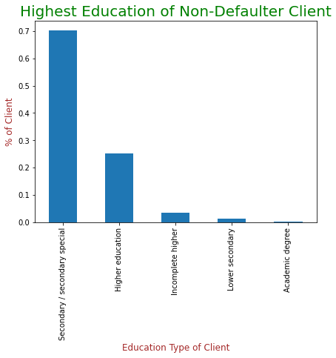
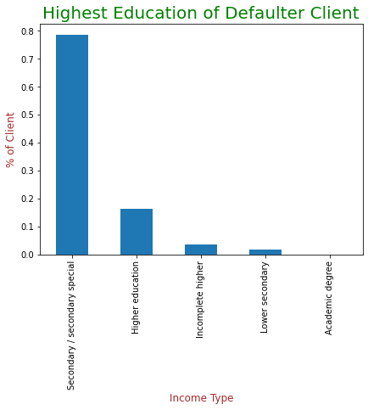
Client Education Type wise Distribution
Very few/Negligible % of Client having Academic degree are found to be loan Defaulter. Financial Institution should process loan to Client having Academic degree

Slide 8
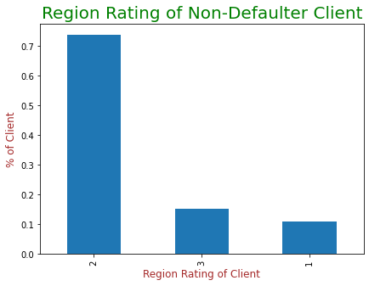
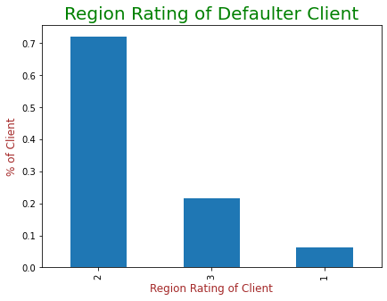
Region wise Distribution
We can observe from the above Bar chart that, client live in Region 1 have a very less % (Less than 5%) to become a loan defaulter. Hence, it is suggested to provide loan to client living in Region 1.

Slide 9
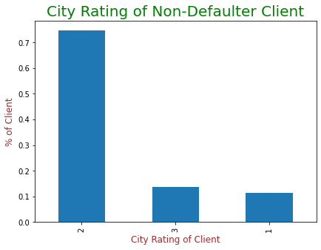
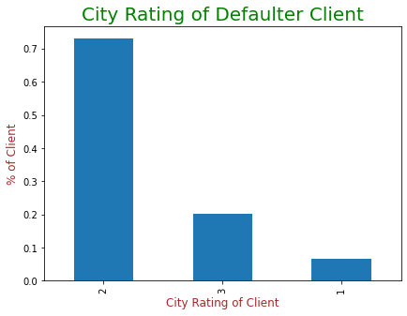
City wise Distribution
It has noticed that, client live in City 3 have a tendency to become loan defaulter (~20%) than to repay loan (~10%). Financial Institutions should avoid to sanction loan to these category clients.
On the other hand, spread of client lives in City 1 have a very less % (Less than 5%) to become a loan defaulter. Hence, loan applications from these clients can be approved on priority.

Slide 10
Bivariate Analysis on Target Variable

Slide 11
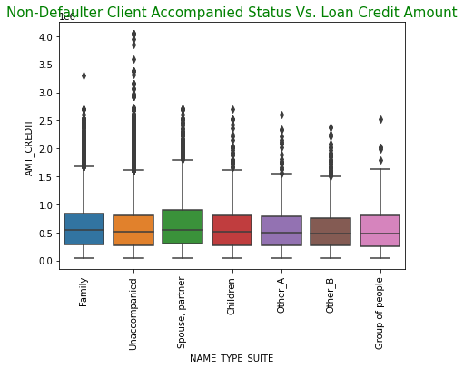
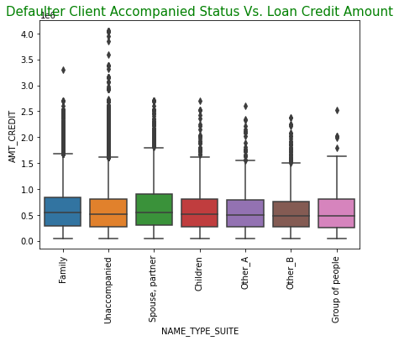
Client Accompany Status Vs. Loan Credit Amount
Non-defaulter Client accompanied by Spouse/Partner have the highest median value and third quartile i.e. upper bound is also higher. Financial Institution should give preference to client accompanied by Spouse/Partner during loan approval.
Other_B and Group of people falls under Defaulter category have low median value which means they have accessed low credit amount from loan still became loan defaulter.

Slide 12
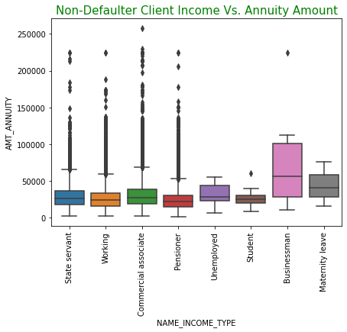
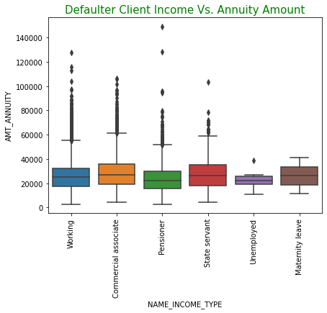
Client Income Type Vs. Loan EMI Amount
Loan Annuity (EMI) amount of Businessman found to be the highest and none of them have faced in loan payment difficulties. Banks/NBFCs should give preference to Businessman during loan approval.
Financial Institutions commercial associate and state servant judiciously as they are most likely to become loan defaulter.

Slide 13
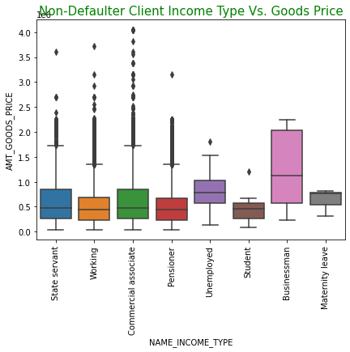
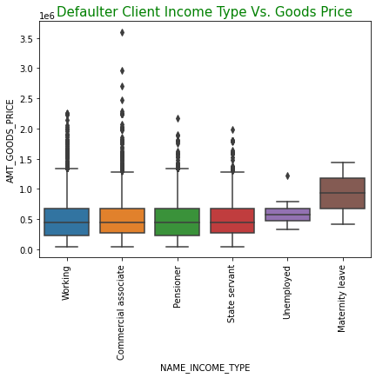
Client Income Type Vs. Goods Price
Businessman has been given highest amount of loan and they never missed to repay the loan. Financial Institution can focus more on adding businessman customer into their bucket list.
On the contrary, customer falls under maternity leave category have given a huge amount of loan and they become a loan defaulter. FI should restrict in sanctioning to loan to such customers.

Slide 14
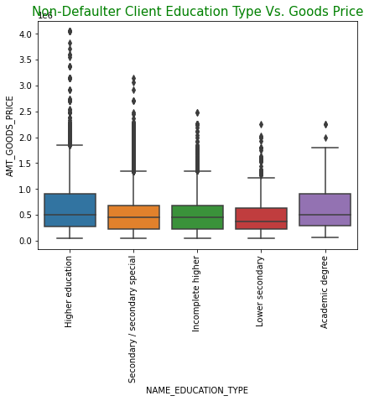
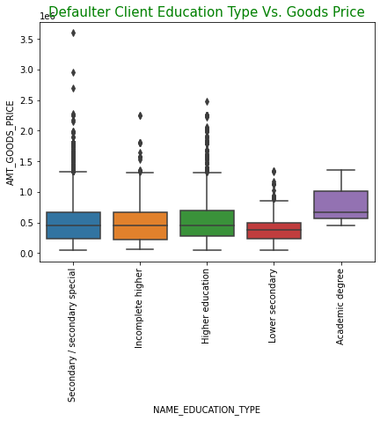
Client Education Type Vs. Goods Price
Client having Higher education and Academic degree have given considerably high loan amount whereas client having academic degree are more likely to be a defaulter. Hence Financial Institutions should prioritize client with Higher education over Academic Degree when considering a high goods price.
On the other hand, client with Lower secondary education have taken lowest amount of loan.

Slide 15
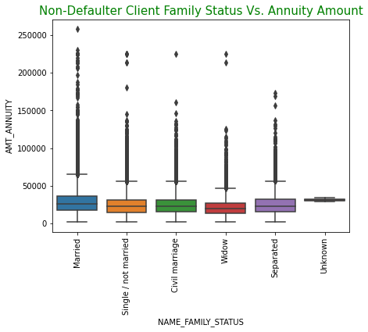
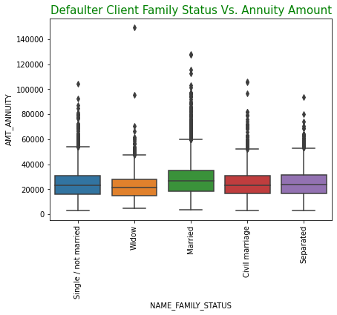
Client Family Status Vs. Annuity Amount
Both Married and Separated Clients are paying high EMI amount whereas Married client are more often facing payment difficulties. On the other hand, Window clients are paying lower EMI amount but consistent in repaying loan. Hence, it is recommended to approve loan to Separated and Widow Clients predominantly.
There is one client category ‘Unknown’ who have not declared their marital status, have never missed to repay the EMI amount.

Slide 16
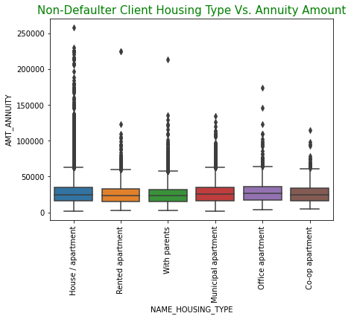
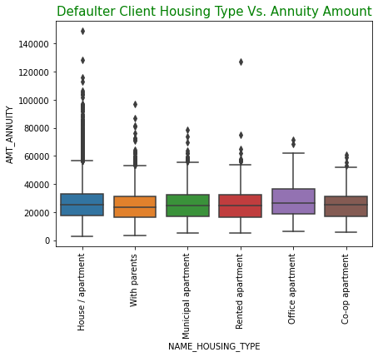
Client Housing Type Vs. Annuity Amount
Clients having own House/apartment and Office apartment are paying highest EMI amount whereas clients having Office apartment are most likely to become loan defaulter. We can observe, a lot of outliers who owned House/apartment as they are paying a very high amount of EMI.
Preference should be given to clients having House/apartment at the time of approving loan.

Slide 17
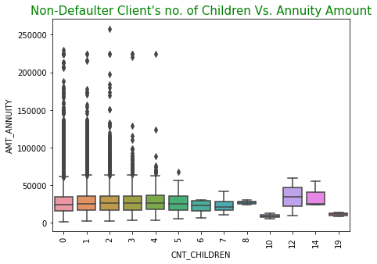
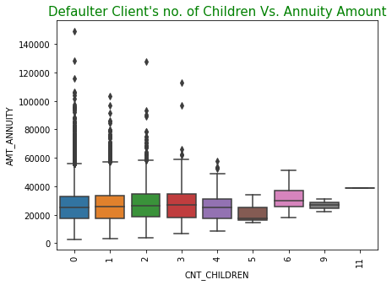
Client Children Count Vs. Annuity Amount
It has noticed that, Clients having 2 to 4 nos. of children are paying highest EMI amount and maintaining uniformity in repaying loan. Clients having children no. 12 and 14 are also paying very high EMI amount but they are very few in numbers.
On the other hand, clients having no. of children more than 5 are paying higher EMI amount and not consistent in repaying loan.
Clients having 2 to 4 children are found to be the most consistent non-defaulter.

Slide 18
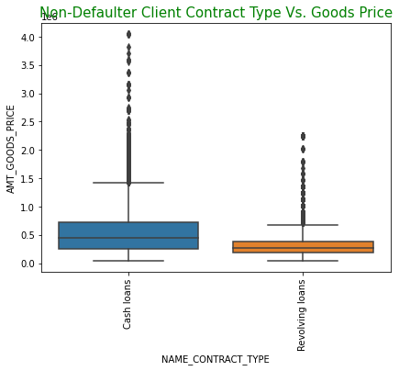
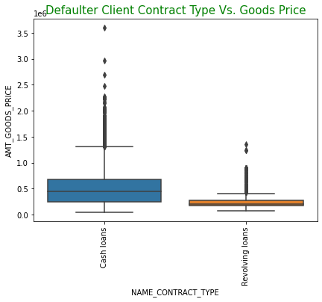
Client Contract Type Vs. Goods Price
It has been observed that, Goods price for Cash loan is always higher than Revolving loan.
As the Goods price is less for Revolving loan, most of the clients taken Revolving loan are able to repay the loan amount.
Hence, Financial Institution should assess the risk in issuing Cash loan of higher amount and can restrict approving Cash loans.

Slide 19
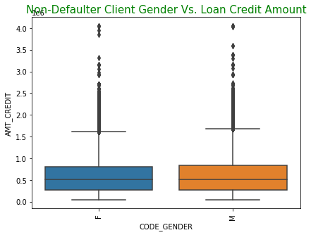
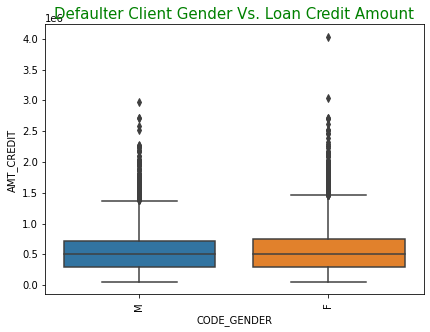
Client Gender Type Vs. Loan Credit Amount
It has been observed from above Boxplot that, Male clients are eligible to access more credit amount from the money loaned and found to be non-defaulter of loan.
On the contrary, Female clients who are eligible to access more credit amount from the money loaned are likely to be loan defaulter.
Hence, Financial Institutions should be given preference to Male clients to access loan credit amount.

Slide 20
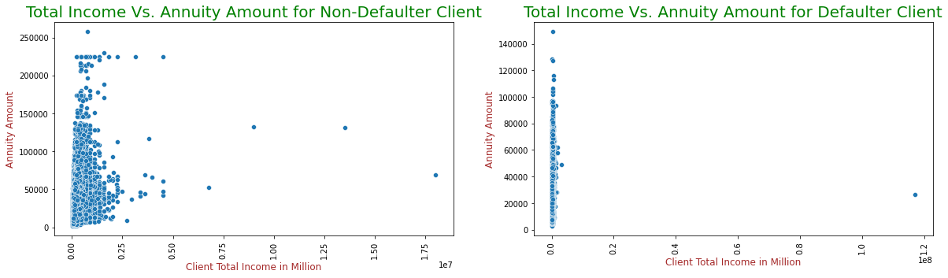
Client Total Income Vs. Annuity Amount
It has been noticed that, most of the non-defaulter clients falls under income range upto 0.25 Million are paying the highest annuity amount.
On the other side, clients having income range very less (Within 0.02 Million) are supposed to pay a very high EMI amount and becoming defaulter.
Hence, it is advisable to approve loan to clients having higher total income.

Slide 21
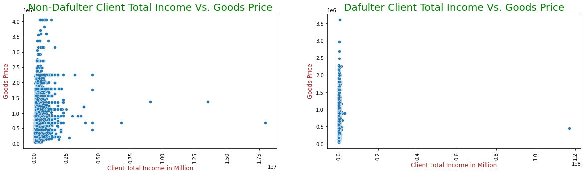
Client Total Income Vs. Goods Price
It has been noticed that, most of the non-defaulter clients falls under income range upto 0.25 Million have taken higher amount of loan.
On the other side, clients having income range very less (Within 0.02 Million) have received a higher amount of loan and subsequently became loan defaulter.
Financial Institution should approve a higher loan amount to clients earning high.

Slide 22
Outliers in Dataframe

Slide 23
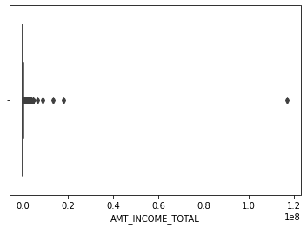
Total Income Amount (AMT_INCOME_TOTAL)
One of the Client have Income of 117 Million which is found to be an outlier.

Slide 24
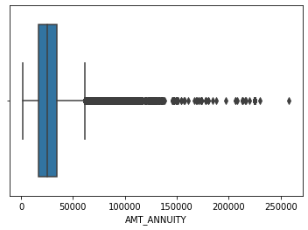
Amount Annuity (AMT_ANNUITY)
Annuity Amount of one of the client has found to be 2,58,025 which is an outlier.

Slide 25
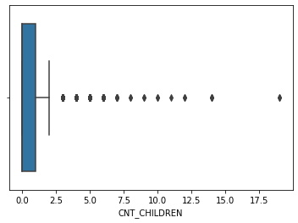
Count of Children (CNT_CHILDREN)
One of the Client having 19 nos. of Children which found to be an outlier.

Slide 26
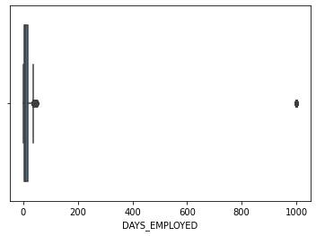
Years of Employment (DAYS_EMPLOYED)
Years of Employment has a value of 1000 years which is surely an outlier.

Slide 27
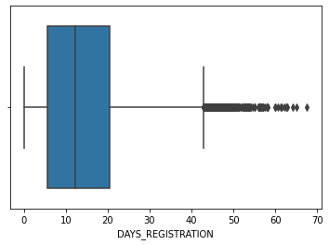
Years of Registration (DAYS_REGISTRATION)
One of the Clint have registered more than 67 years back which is an outlier.

Slide 28
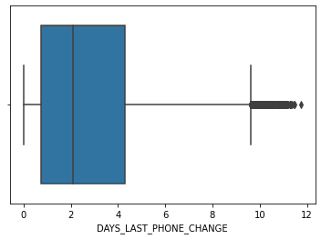
Last Phone Change (DAYS_LAST_PHONE_CHANGE)
Last Phone Change Days has a value close to 11.75 years which seems to beyond the normal value range and we can consider this as an outlier

Slide 29
Univariate Analysis on Previous Loan Application

Slide 30
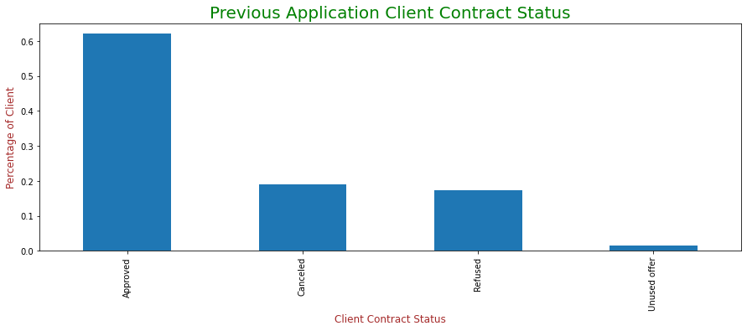
Client Contract Status
More than 60% previous loan applications had been approved by the Financial Institution.
Both Cancelled and Refused applicants percentages are less than 20.
Loan has been offered to some clients and they have not utilized the offer. Numbers are very less in this category.

Slide 31
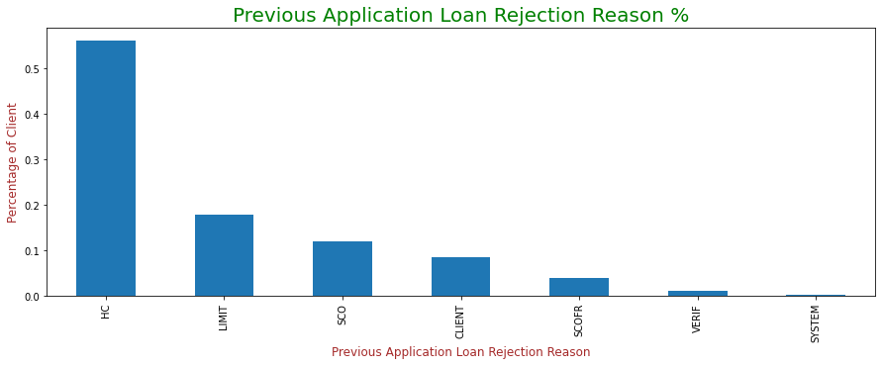
Loan Rejection Reason
Most of the previous loan application got rejected due to HC reason followed by LIMIT and SCO reasons.
Very few loan application got rejected due to SYSTEM reasons.

Slide 32
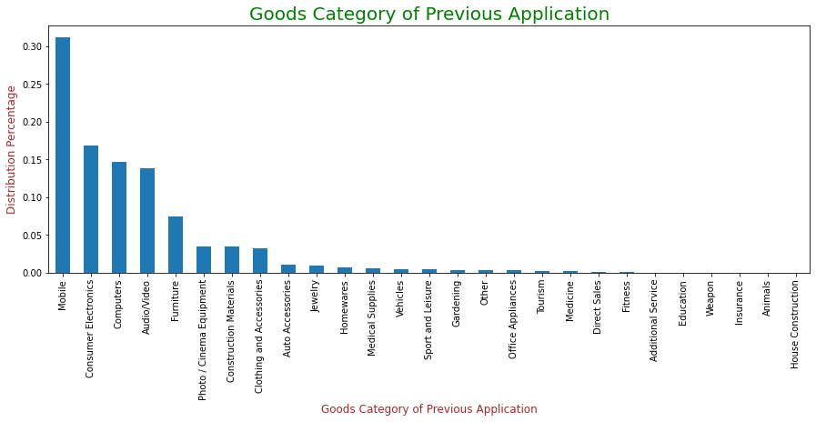
Goods Category
As per previous application data, loan has taken mostly to purchase Mobile followed by Consumer Electronics & Computers.
Least no. of loan applicants had applied loan for House Construction.

Slide 33
Bivariate Analysis on Previous Loan Application

Slide 34
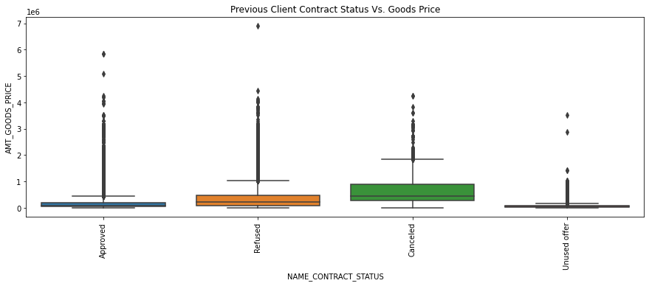
Client Contract Status Vs. Goods Price
Loan applied for higher value stand cancelled or refused by the Financial Institution.
Loan got approved when the loan amount (Goods price) is comparatively lesser.

Slide 35
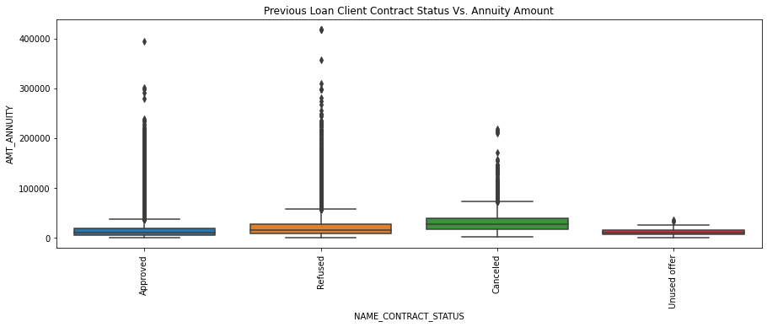
Client Contract Status Vs. Annuity Amount
Loan applied for higher value would have high EMI amount. Whenever, EMI amount supposed to be evaluated high, it got cancelled or refused by the Financial Institution.
Clients whose Loan got approved are paying lesser Annuity Amount.

Slide 36
Summary
Current Application
Financial Institution should focus on Male applicant who are likely to repay the loan and access can be given for more credit amount on loan applied for.
Financial Institution can consider approving loan to Businessman and Student who are most likely to repay the loan.
Financial Institution should prioritize in sanctioning loan to Client having a) higher total income, b) bagged Academic degree, c) accompanied by Spouse/Partner, d) Separated and Widow.
It is suggested to provide loan to client live in Region 1 and city 1.
Client falls under maternity leave category should be avoided when sanctioning loan.
Preference should be given to clients having own House/apartment and children count between 2 to 4.
Financial Institution should assess the risk in issuing Cash loan of higher amount and can restrict approving Cash loans. Revolving loan of lower amount can be given priority over cash loan.

Slide 37
Summary
Previous Application
More than 60% previous loan applications had been approved by the Financial Institution.
Most of the previous loan application got rejected due to HC reason followed by LIMIT and SCO reasons.
Client has taken loan mostly to purchase Mobile followed by Consumer Electronics & Computers.
Loan applied for higher value stand cancelled or refused by the Financial Institution.
Loan got approved when the amount (Goods price) is comparatively lesser.

Slide 38


